Slide 1
Class 0
Introduction & Overview of the
International Economy by
Alan V. Deardorff
University of Michigan
2022
PubPol/Econ 541

Slide 2
Today
Introduce ourselves
Course Information
Overview of the world economy
  Far more slides than we’ll get through
  Look at them at your leisure, if you wish

Slide 3
Introductions
Me:
  I am Alan Deardorff
  PhD in Economics from Cornell
  Professor at UM since 1970
    now retired - “Emeritus” – but still teaching this course
  Call me “Alan”
    If you are not comfortable with that, then Professor Deardorff
You:

Slide 4
Introductions
Keep your
  microphone off when not speaking
  video on always, if you are willing (email me if you prefer not to)
I’ll now call on you to introduce yourself
  Who you are,
  What you want to be called,
  What program and year you are in, (MPP, MAE, etc.)
  Where you are from, and
  Any particular questions (or answers) you have about international economics.

Slide 5
Pause for Introductions

Slide 6
Course Information
Complete information is on my public website
  Access http://www-personal.umich.edu/~alandear/courses/541/541.html
  Or google “Deardorff”, then Courses / 541
  Or link from Canvas homepage

Slide 7
Course Information
Class format
  Mix of lecture and discussion all live via Zoom
  Lecture material will draw on PowerPoint slides
    Available on website
    Before and after
  Discussion will mostly draw upon Questions posted for each class
    Via “Questions on Readings” on public course web site
      Questions only well before class
      Questions and Answers (Q&A) after Quiz on that material
    Questions also linked on Syllabus

Slide 8
Course Information
Communication:
  Class will be synchronous via Zoom. DO ask questions
    Raise hand (but I’m not sure I’ll see it)
    Interrupt with your voice
  Regular Zoom office hours: MTh 10-11
  Email: alandear@umich.edu
    With questions, comments, etc.
    To request a Zoom meeting

Slide 9
Course Information
Survey:
  Please complete the Getting-to-know-you survey
  Find it under Quizzes in Canvas
    Scroll way down
    I wanted it by last night, but it is open through Sunday, Sep 4, and I need it from all of you

Slide 10
Course Information
Requirements:
  Weekly Quizzes (count only best 10)
  3 Papers (done in assigned groups)
  Class participation
  News
    We’ll discuss, weekly
    See tabulation on my website

Slide 11
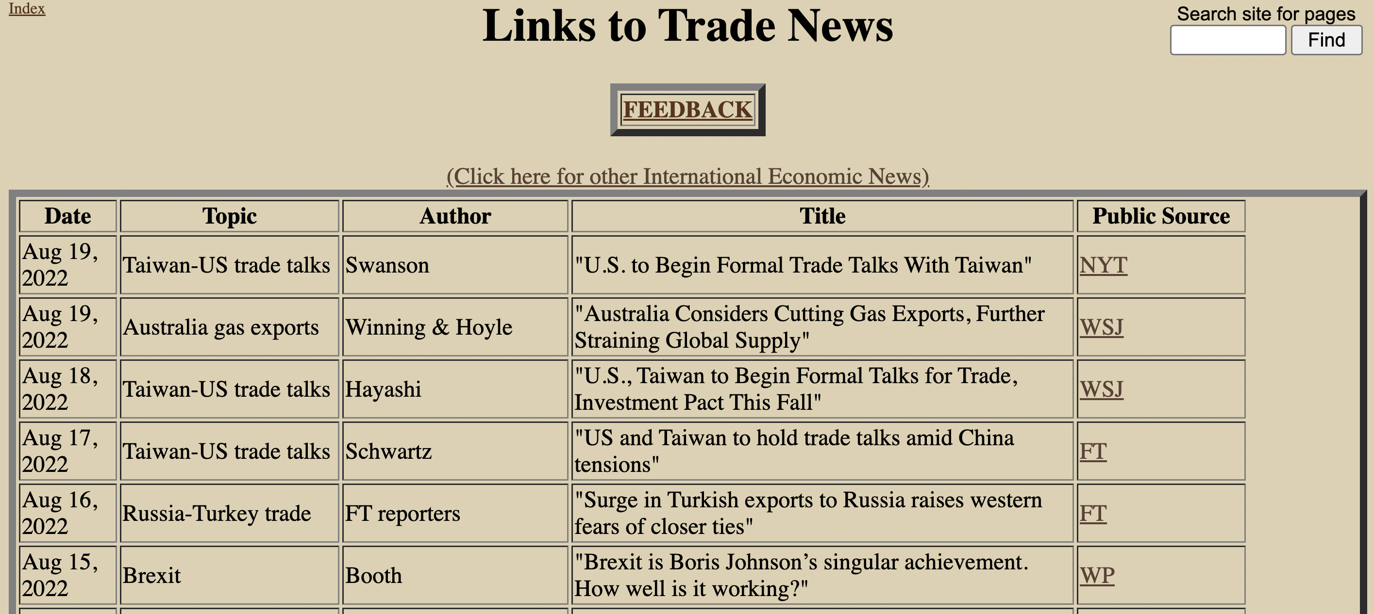

Slide 12
1-8/2015
Greece Crisis
3/18-1/20
Trade war
2011-2013
Eurozone Crisis
6/23/2016
Brexit Vote
2-?/20
COVID-19
Notes:
Chart goes through May 25, 2019

Slide 13
Course Information
Classroom Reserved
  Room 1220 Weill Hall is reserved for your use during class times: TTh 8:30-9:50
  Feel free to bring your laptop there to attend class free of disruptions
  You may meet other class members there in person. Follow UM protocols for masking.

Slide 14
Plan for Course
Recent trade events (trade war, etc.)
Tariff/quota analysis (needed for papers)
Int’l macro (exchange rates, deficit)
Institutions (Int’l, national)
Trade barriers (NTBs)
Trade theory (General equilibrium)
Uses & abuses (FTAs, remedies, sanctions)

Slide 15
Pause for Discussion

Slide 16
Outline
“Globalization”
Trade
Policies that Affect Others

Slide 17
“Globalization”
Means different things to different people
  My definitions (see my online Glossary):
    1. The increasing world-wide integration of markets for goods, services and capital.
    2. Also role of MNCs, IMF, WTO, World Bank.
    3. Elsewhere: domination by United States.
  Some see good, others see bad

Slide 18
Outline
“Globalization”
Trade
Policies that Affect Others

Slide 19
Country Interactions: Trade
Trade (per CIA, 2017 est. [most recent!])
  World exports: $17.31 trillion
  (compare world GDP of $80 trillion)
  World trade has grown faster than world GDP most years
    Declined with the world recession of 2008, then recovered
    Slowed down in 2015-16, then resumed in 2017
    Collapsed in 2020 with the pandemic
  What’s next? We don’t know!
Notes:
Source: Factbook, country (world)
World Factbook / World / Economy / Exports
World Factbook / World / Economy / GDP (official exchange rate)
(Can get more recent country data there, and add them up in Numbers, but years are not all the same.

Slide 20
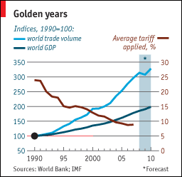
Notes:
From Economist “Barriers to Entry” article

Slide 21
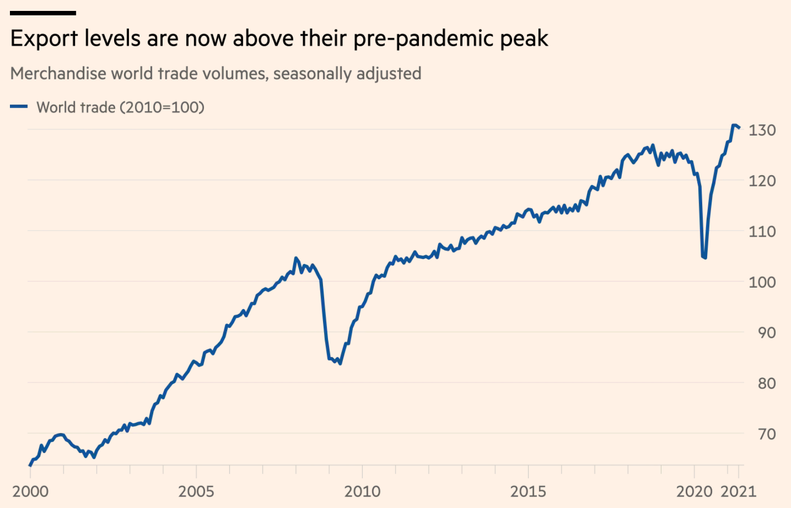
Pandemic
World Recession
Source: FT 8/25/21
Notes:
Jones, “Supply chains are a mess. So how come trade is booming?” Financial Times, August 25, 2021
https://www.ft.com/content/10f66c95-420c-4d2f-b04f-d6c8ab5af91f

Slide 22
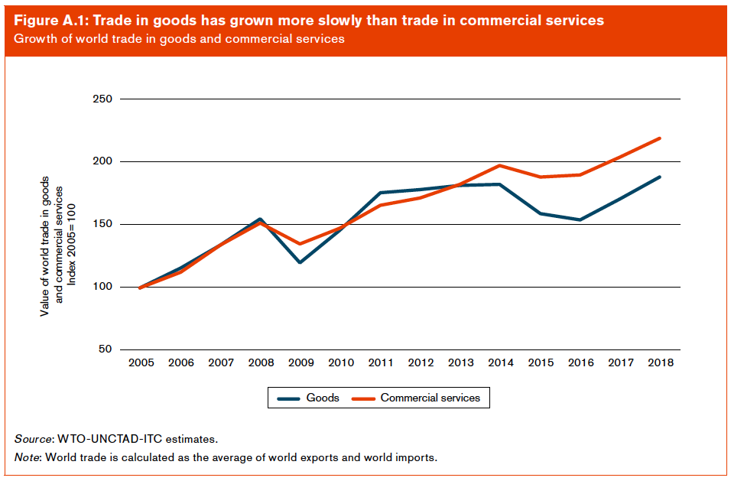
Notes:
WTO, World Trade Report 2019: The future of services trade
https://www.wto.org/english/res_e/booksp_e/00_wtr19_e.pdf

Slide 23
Pause for Discussion

Slide 24
Country Interactions: Trade
See below for
  Who trades most?
  Who trades with whom?
  Share of trade in GDP
  US:
    What do we export/import?
    To/from whom?
Notes:
Source: https://www.cia.gov/cia/publications/factbook/rankorder/2078rank.html

Slide 25
Who Trades the Most?
($ b. & % share, 2020)
Exporters |  |  | Importers
 | Value | Share |  | Value | Share
China | 2,591 | 14.7 | US | 2,408 | 13.5
US | 1,432 | 8.1 | China | 2,056 | 11.5
Germany | 1,380 | 7.8 | Germany | 1,171 | 6.6
Netherlands | 641 | 3.8 | UK | 635 | 3.6
Japan | 723 | 3.6 | Japan | 635 | 3.6
World | 17,583 | 100.0 | World | 17,812 | 100.0
Source: WTO, World Trade Statistical Review, 2021, Table A6
Notes:
https://www.wto.org/english/res_e/statis_e/wts2021_e/wts2021chapter05_e.pdf

Slide 26
Who Trades the Most?
(Excluding intra-EU-27)
($ b. & % share, 2018)
Exporters |  |  | Importers
 | Value | Share |  | Value | Share
China | 2,591 | 18.1 | US | 2,408 | 16.5
EU-27* | 2,209 | 15.4 | China | 2,056 | 14.0
US | 1,432 | 10.0 | EU-27* | 1,958 | 13.4
Japan | 641 | 4.5 | UK | 635 | 4.3
Korea, S** | 512 | 3.6 | Japan | 635 | 4.3
World | 14,334 | 100.0 | World | 14,634 | 100.0
*EU external only
**Source has Hong Kong, China 549, but 513 is re-exports
Source: WTO, World Trade Statistical Review, 2021, Table A7
Notes:
https://www.wto.org/english/res_e/statis_e/wts2021_e/wts2021chapter05_e.pdf

Slide 27
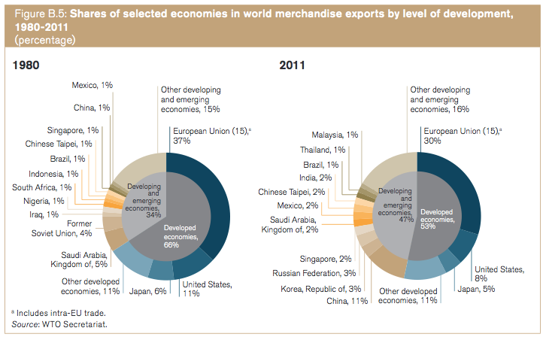
Merchandise Export Shares, 1980 to 2011
WTO, World Trade Report 2013

Slide 28
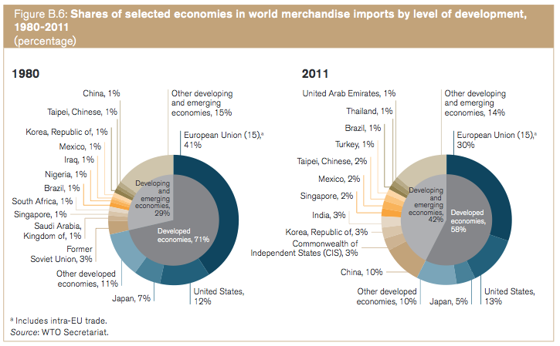
Merchandise Import Shares, 1980 to 2011
WTO, World Trade Report 2013

Slide 29
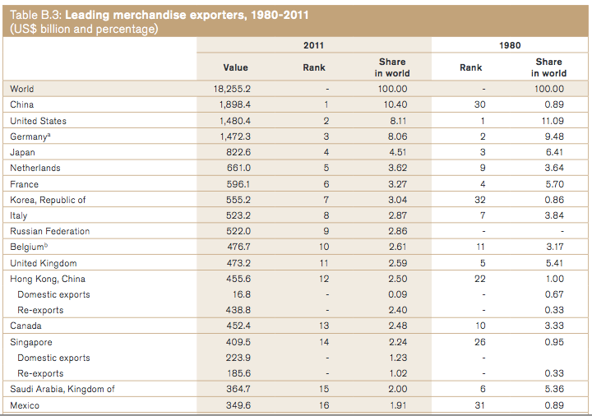
WTO, World Trade Report 2013

Slide 30
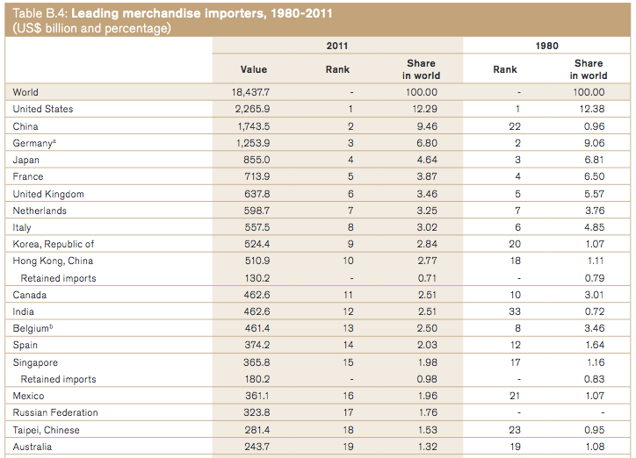
WTO, World Trade Report 2013

Slide 31
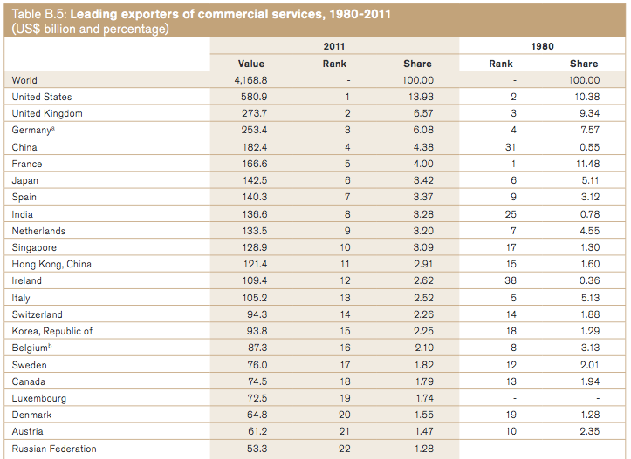
WTO, World Trade Report 2013

Slide 32
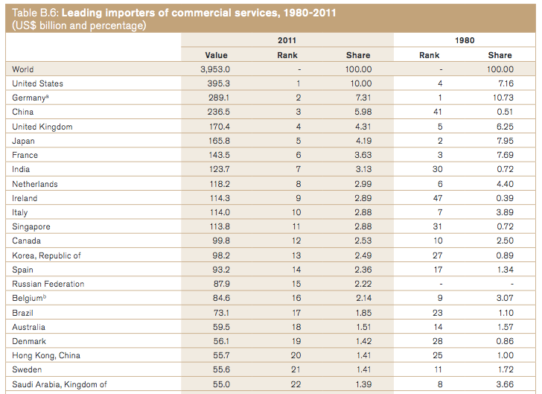
WTO, World Trade Report 2013

Slide 33
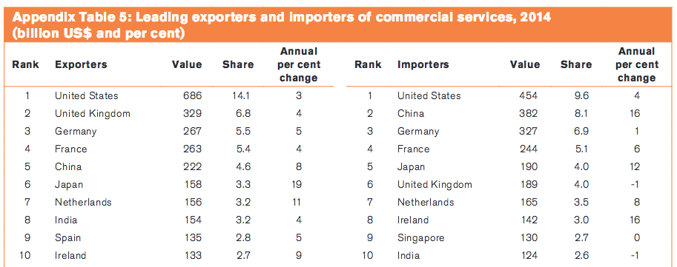
WTO, World Trade Report 2015

Slide 34
Importance of Trade for Countries?
(GDP in US$ b., Exports % of GDP,
Selected countries, 2017)
 | Exports | Exports/GDP
United States | 2,377 | 11%
Japan | 1,084 | 21%
Germany | 2,004 | 52%
Canada | 619 | 36%
India | 572 | 20%
Mexico | 492 | 39%
Netherlands | 858 | 95%
Singapore | 627 | 169%
Philippines | 1311 | 35%
Nepal | 0.8 | 3%
Source: CIA World Fact Book
Notes:
See Intro Data.xls Exports per GDP
(IMF data would be better here)

Slide 35
Importance of Trade for Countries?
A Few More of Interest
 | GDP | Exports/GDP
China | 2,490 | 17%
Hong Kong | 569 | 155%
Korea, South | 684 | 42%
Korea, North (2013) | 3.0 | 11%
Burma | 16.3 | 21%
Israel | 105 | 27%
Source: CIA World Fact Book
Notes:
See Intro Data.xls Exports per GDP
(IMF data would be better here)

Slide 36
Who Trades with Whom?
($ b., 2014, Intra- and inter-regional merchandise trade)
 | Destination:
Origin: |  | North Amer. | Latin Amer. | Eur. | Asia | Africa | Other
North Amer. |  | 1251 | 214 | 379 | 504 | 43 | 97
Latin Amer. |  | 173 | 179 | 114 | 170 | 18 | 26
Europe |  | 540 | 119 | 4665 | 738 | 221 | 447
Asia |  | 1065 | 185 | 900 | 3093 | 207 | 428
Africa |  | 39 | 29 | 201 | 152 | 98 | 20
Other |  | 128 | 18 | 532 | 828 | 51 | 273
World |  | 3195 | 744 | 6792 | 5485 | 639 | 1292
Source: WTO, International Trade Statistics, 2015, Table I.4
Note: This source is no longer published, and its replacement lacks these data.
Notes:
Source: http://www.wto.org/english/res_e/statis_e/its2015_e/section1_e/i04.xls

Slide 37
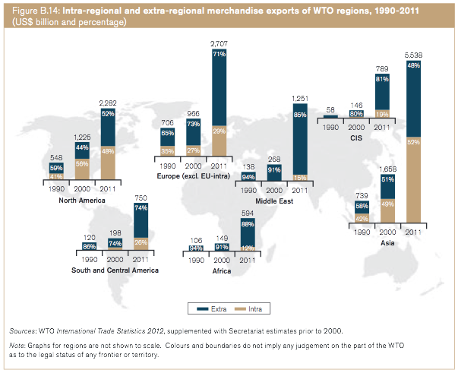
WTO, World Trade Report 2013
Notes:
WTO, World Trade Report 2013

Slide 38
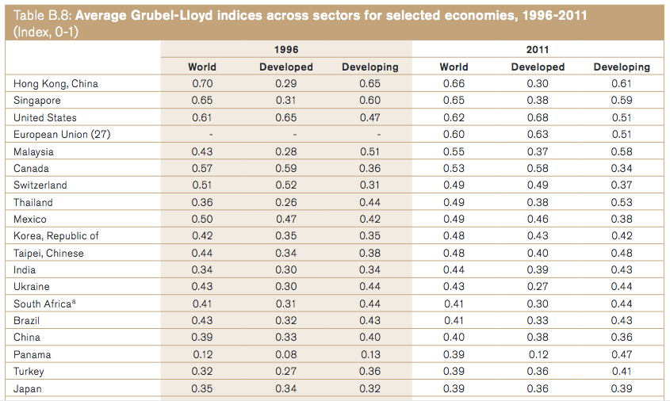
of Intra-Industry Trade
WTO, World Trade Report 2013
Notes:
WTO, World Trade Report 2013

Slide 39
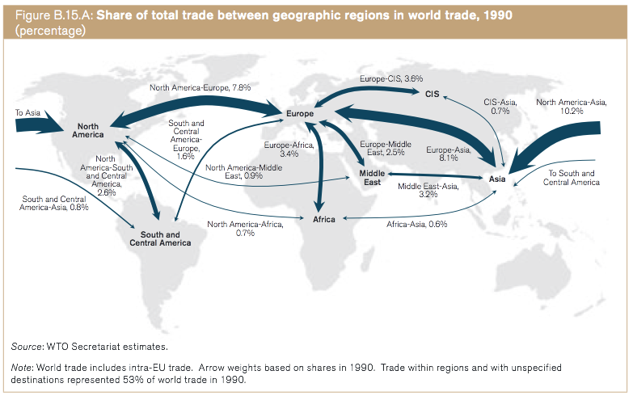
WTO, World Trade Report 2013
Notes:
WTO, World Trade Report 2013

Slide 40
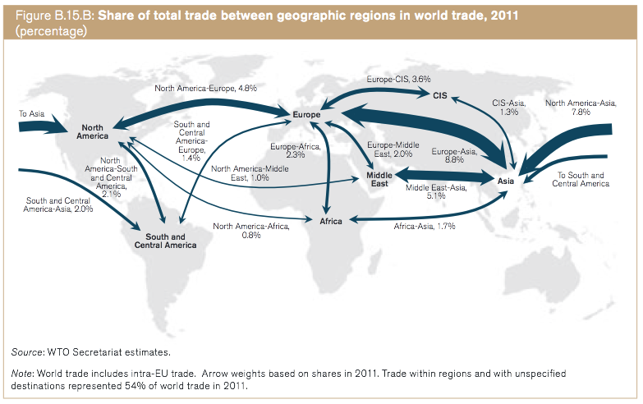
WTO, World Trade Report 2013
Notes:
WTO, World Trade Report 2013

Slide 41
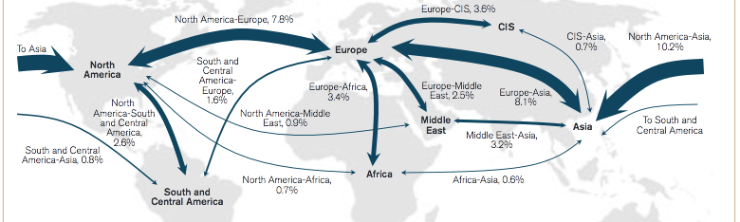
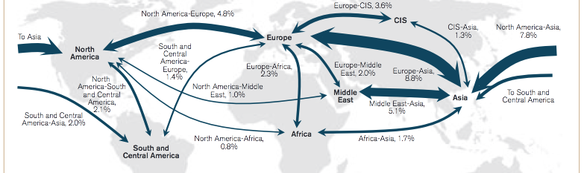
1990
2011
WTO, World Trade Report 2013
Notes:
WTO, World Trade Report 2013

Slide 42
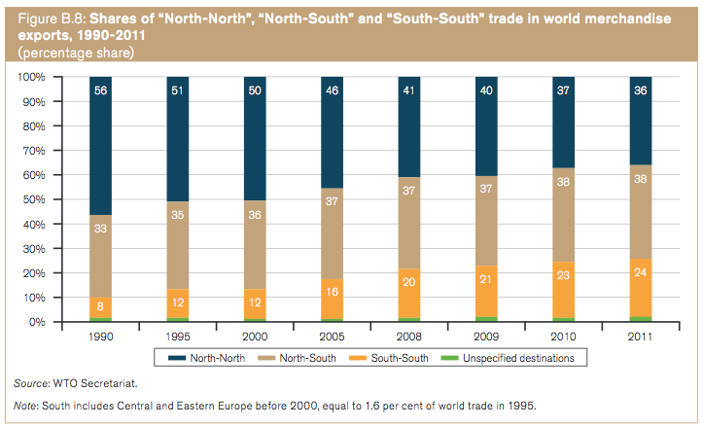
WTO, World Trade Report 2013
Notes:
WTO, World Trade Report 2013

Slide 43
Pause for Discussion

Slide 44
What Does the World Trade?
($ b. 2014 merchandise exports)
 | Value
All Products | 17,797
Agriculture | 1,765
Fuels & Mining | 3,789
Manuf. | 12,243
Source: WTO, International Trade Statistics, 2015, Table II.1
Note: This source is no longer published, and its replacement lacks these data.
Notes:
Source: http://www.wto.org/english/res_e/statis_e/its2015_e/section2_e/ii01.xls
Columns for 05-13 and 2009 kept from earlier.

Slide 45
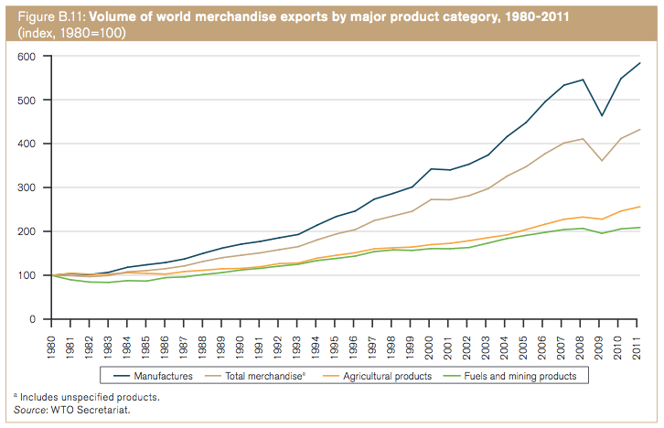
WTO, World Trade Report 2013
Notes:
WTO, World Trade Report 2013

Slide 46
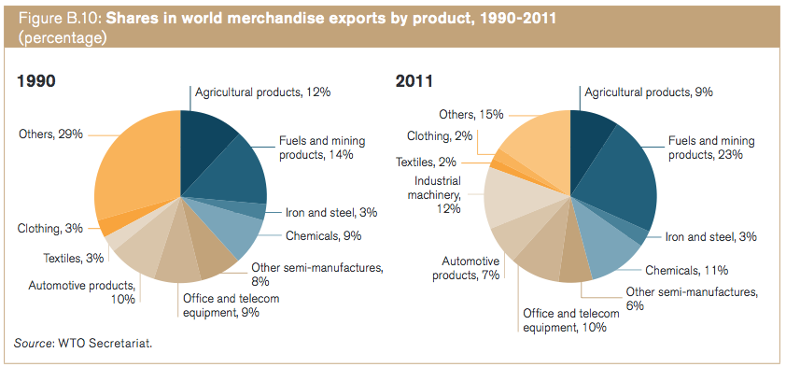
WTO, World Trade Report 2013
Notes:
WTO, World Trade Report 2013

Slide 47
What Does the US Trade?
($ b. 2011)
Did
(Not available since 2011)
 | Exports | Imports
Total | 1,497.4 | 2,235.8
Agriculture | 140.0
Petroleum |  | 462.3
Industrial supplies | 496.4 | 319.8
Capital goods, exc. auto | 493.2 | 513.4
Automotive | 133.1 | 255.2
Other non-ag | 234.6
Other non-petrol |  | 685.1
Source: Economic Report of the President, Feb 2013, Table B-104.
Notes:
Source: http://www.gpo.gov/fdsys/pkg/ERP-2013/xls/ERP-2013-table104.xls
NOTE: ERP no longer providing this table since 2014.

Slide 48
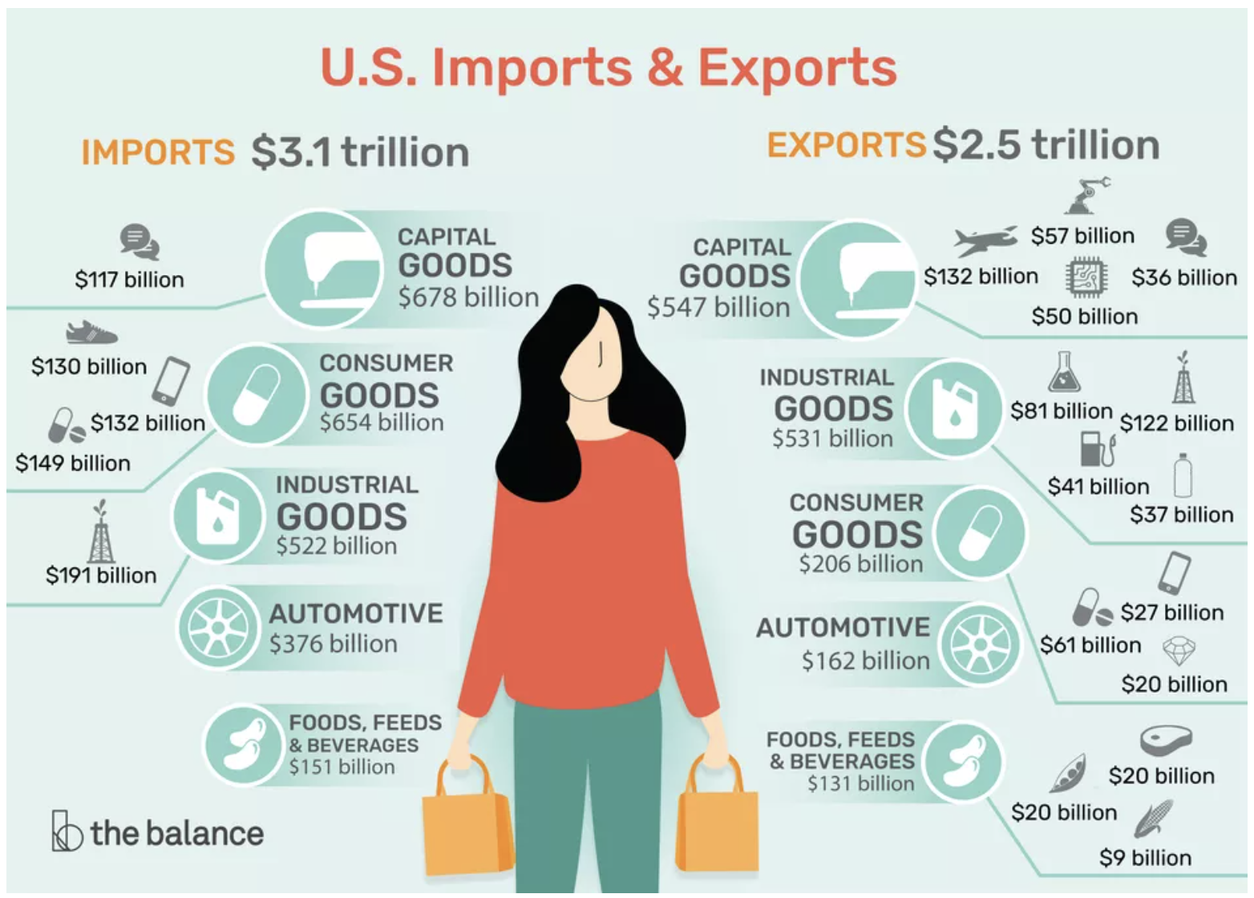
What Does the US Trade?
2019
Source: Economic Report of the President, Feb 2013, Table B-104.
Notes:
The Balance
https://www.thebalance.com/u-s-imports-and-exports-components-and-statistics-3306270

Slide 49
What Does the US Trade?
US imports are much larger than US exports
US is a big…
  Exporter of agricultural products
  Importer of oil (but that’s been falling)
  Exporter and importer of capital goods (i.e., machines for making things)

Slide 50
Trade of US States
US states differ substantially in the importance of international trade to them

Slide 51
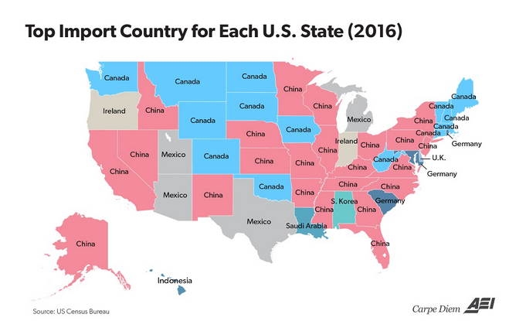
Source: Perry and Balliou (2017)
Notes:
Perry, Mark J. and Olivier Ballou, “Every state’s top foreign trading partner for imports and exports in 2016,” Washington Examiner, March 2, 2017. http://www.aei.org/publication/every-states-top-foreign-trading-partner-for-imports-and-exports-in-2016/ [Didn’t do notes on this.]

Slide 52
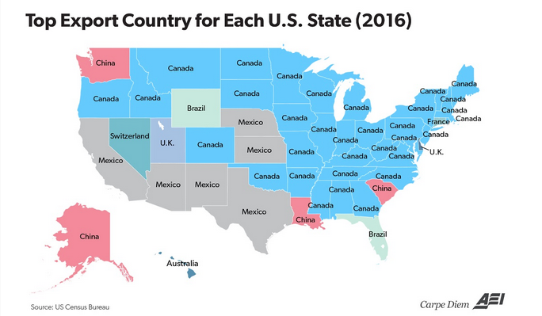
Source: Perry and Balliou (2017)
Notes:
Perry, Mark J. and Olivier Ballou, “Every state’s top foreign trading partner for imports and exports in 2016,” Washington Examiner, March 2, 2017. http://www.aei.org/publication/every-states-top-foreign-trading-partner-for-imports-and-exports-in-2016/ [Didn’t do notes on this.]

Slide 53
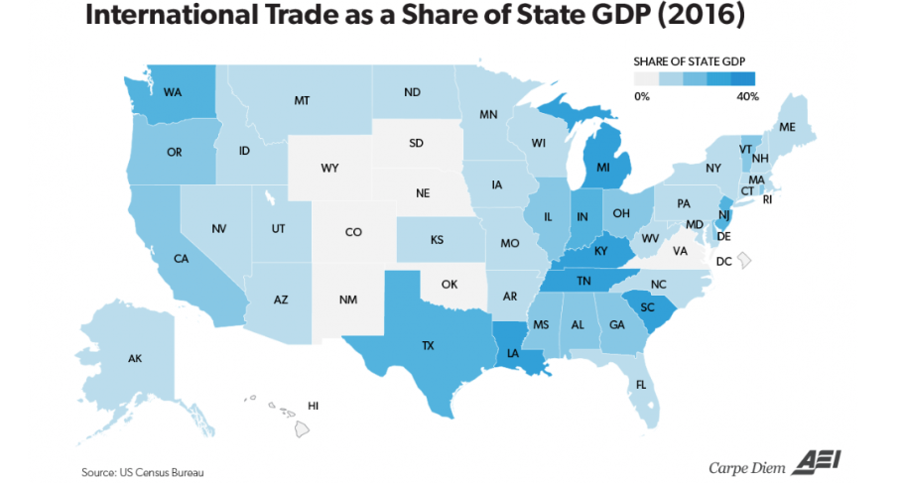
Source: Perry (2017)
Notes:
Perry, Mark J., “How important is international trade to each US state’s economy? Pretty important for a lot of our states,” American Enterprise Institute, October 22, 2017. [6p] http://www.aei.org/publication/how-important-is-international-trade-to-each-us-states-economy-pretty-important-for-a-lot-of-states/

Slide 54
Supply Chains
Much trade today is intermediate inputs.
Supply chains cross national borders multiple times
Example from Black et al., “One Tiny Widget’s Dizzying Journey Shows Just How Critical Nafta Has Become” Bloomberg, Feb 2, 2017

Slide 55
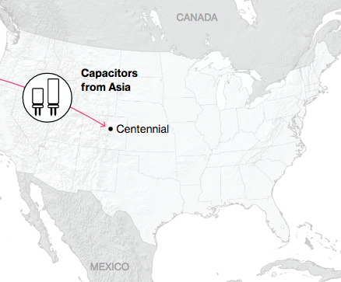
NAFTA and the Auto Supply Chain
Black, Diamond, and Merrill, “One Tiny Widget’s Dizzying Journey Shows Just How Critical Nafta Has Become,” Bloomberg, February 2, 2017.

Slide 56
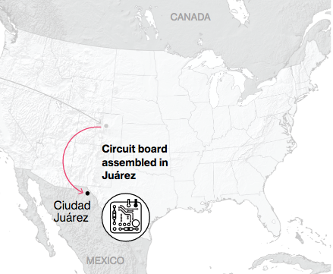
NAFTA and the Auto Supply Chain
Black, Diamond, and Merrill, “One Tiny Widget’s Dizzying Journey Shows Just How Critical Nafta Has Become,” Bloomberg, February 2, 2017.

Slide 57
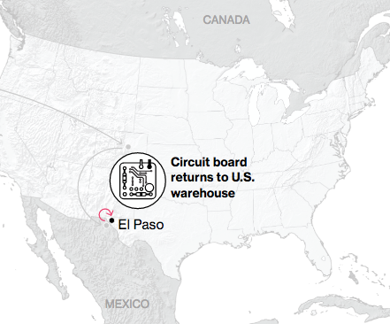
NAFTA and the Auto Supply Chain
Black, Diamond, and Merrill, “One Tiny Widget’s Dizzying Journey Shows Just How Critical Nafta Has Become,” Bloomberg, February 2, 2017.

Slide 58
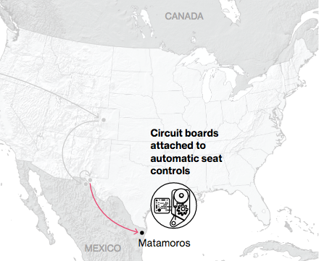
NAFTA and the Auto Supply Chain
Black, Diamond, and Merrill, “One Tiny Widget’s Dizzying Journey Shows Just How Critical Nafta Has Become,” Bloomberg, February 2, 2017.

Slide 59
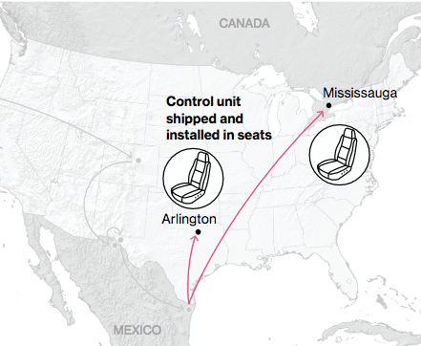
NAFTA and the Auto Supply Chain
Black, Diamond, and Merrill, “One Tiny Widget’s Dizzying Journey Shows Just How Critical Nafta Has Become,” Bloomberg, February 2, 2017.

Slide 60
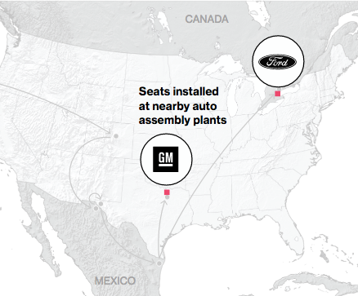
NAFTA and the Auto Supply Chain
Black, Diamond, and Merrill, “One Tiny Widget’s Dizzying Journey Shows Just How Critical Nafta Has Become,” Bloomberg, February 2, 2017.

Slide 61
Pause for Discussion

Slide 62
Outline
“Globalization”
Trade
Policies that Affect Others

Slide 63
Ways that countries interact economically
  Policies that affect other countries
    Direct
    Indirect

Slide 64
Ways that countries interact economically
  Policies that affect other countries
    Direct
      Trade policies (tariffs, quotas, FTAs, anti-dumping,…)
      Foreign aid
      Capital controls
      Exchange rate management
      Immigration restrictions
    Indirect

Slide 65
Ways that countries interact economically
  Policies that affect other countries
    Indirect
      Subsidies (esp. agriculture)
        US farm subsidies > foreign aid
      Macro policies (monetary, fiscal)
        Exchange-rate policies
      Environmental policies
      Standards
        Labor
        Health & safety
        Norms

Slide 66
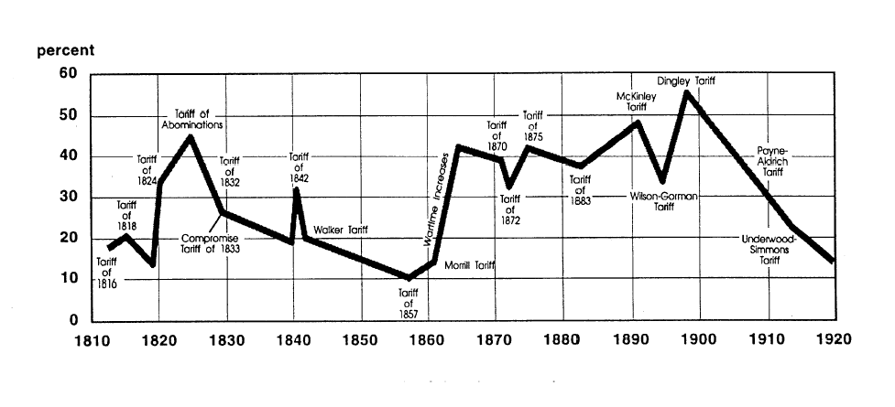
US tariff history: 1810-1920
Today
landandfreedoml.org
Notes:
Source: landandfreedom.org

Slide 67
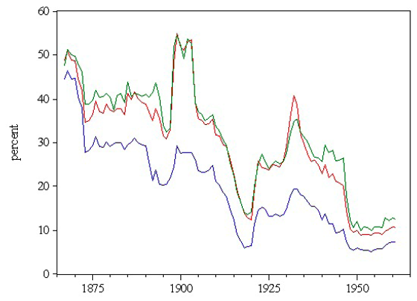
US tariff history: 1865-1960
Smoot-Hawley
Average tariff
Today
Irwin, “Trade Restrictiveness and Deadweight Losses from U.S. Tariffs,” 2008, Fig 1.
Notes:
Source: Irwin, Doug, “Trade Restrictiveness and Deadweight Losses from U.S. Tariffs,” 22 December 2008, Figure 1.

Slide 68
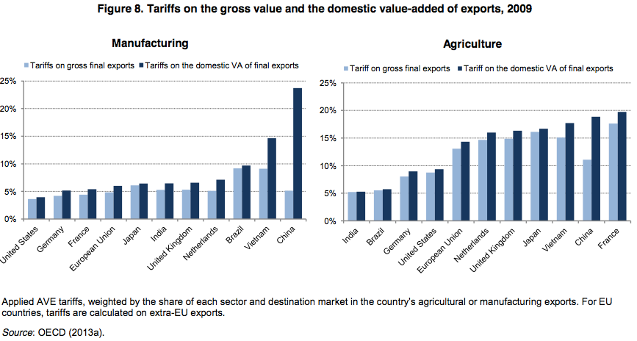
OECD, Global Value Chains: Challenges, Opportunities, and Implications for Policy, 2014
Notes:
WTO, World Trade Report 2013

Slide 69
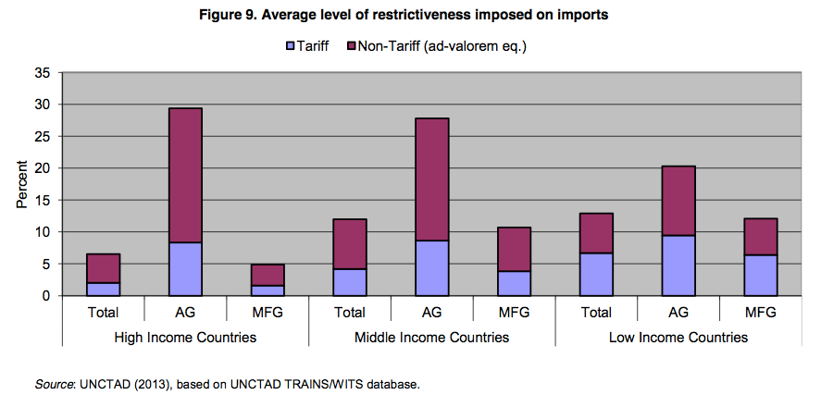
OECD, Global Value Chains: Challenges, Opportunities, and Implications for Policy, 2014
Notes:
WTO, World Trade Report 2013

Slide 70
Trade Agreements
Past
  GATT Rounds: Multilateral reductions in tariffs and other barriers
    Uruguay Round created WTO in 1995
  European Economic Community (now EU)
    Customs union
  NAFTA = North American Free Trade Agreement
    Free trade among US, Canada, Mexico
  Other FTAs: Several hundred in force today

Slide 71
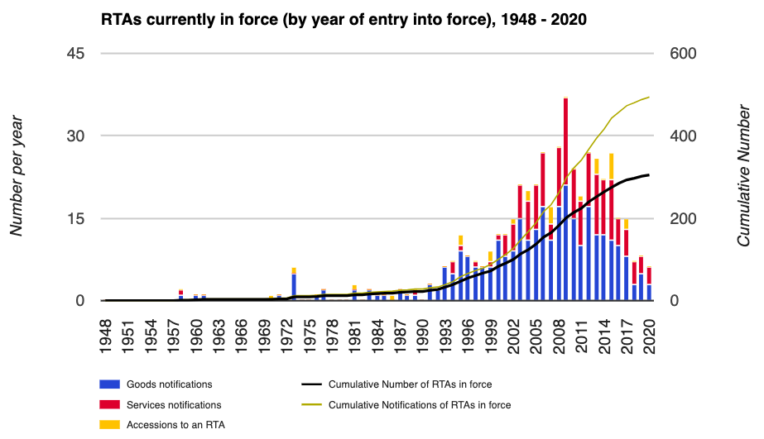
WTO
Notes:
WTO, http://rtais.wto.org/UI/PublicMaintainRTAHome.aspx

Slide 80
Trade Agreements
Present
  Doha Round: Multilateral negotiations, begun 2001
    Negotiations limped along until December 2015
    Round ended in failure at 2015 WTO Ministerial in Nairobi
  Trans-Pacific Partnership (TPP)
    12 country-FTA, “21st century trade agreement”
    Would have included: US, Japan and others
    Trump pulled out
    Other eleven formed CPTPP, effective 12/30/18:
      Comprehensive and Progressive Agreement for Trans-Pacific Partnership

Slide 81
Trade Agreements
Most Recent at WTO Ministerial Meetings
  “Bali Package” on Trade Facilitation
    December 2013
    First ever agreement reached under WTO
  The 2015 Nairobi commitment to abolish export subsidies for farm products
  Essentially none at 2017 WTO Ministerial in Buenos Aires
  Was planned for June 2020, Kazakhstan
    Postponed due to Covid-19
    Finally happened June 2022 in Geneva, Switzerland

Slide 82
Pause for Discussion

Slide 83
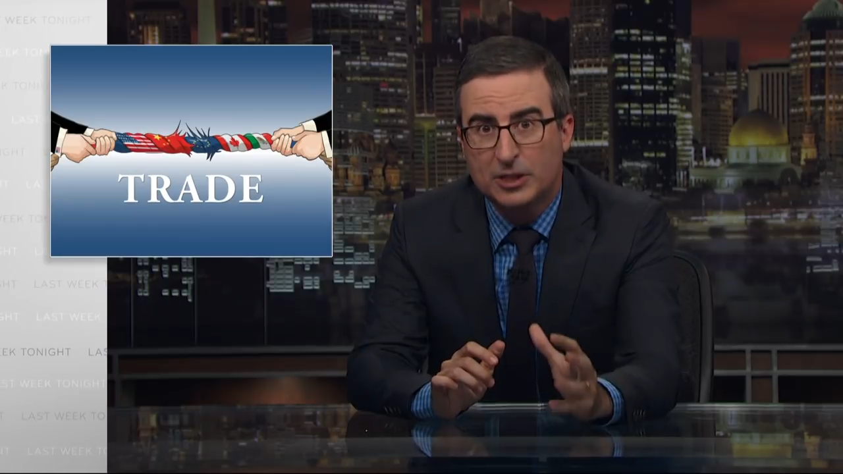
John Oliver: “Trade” 8/19/18 Tariffs
Notes:
https://www.hbo.com/content/dam/hbodata/series/last-week-tonight-with-john-oliver/promo/s5/180820-ep140-trade-1920.jpg/_jcr_content/renditions/cq5dam.web.1200.675.jpeg

Slide 84

Fox News on Trump Tariffs
Notes:
https://www.youtube.com/watch?v=w86g_pduTiI

Slide 85
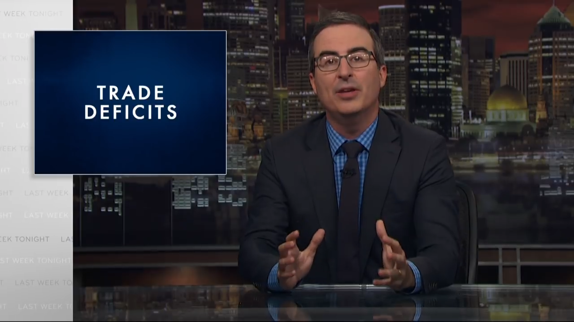
John Oliver: “Trade” 8/19/18 Trade Deficit
Notes:
https://www.hbo.com/content/dam/hbodata/series/last-week-tonight-with-john-oliver/promo/s5/180820-ep140-trade-1920.jpg/_jcr_content/renditions/cq5dam.web.1200.675.jpeg

Slide 86
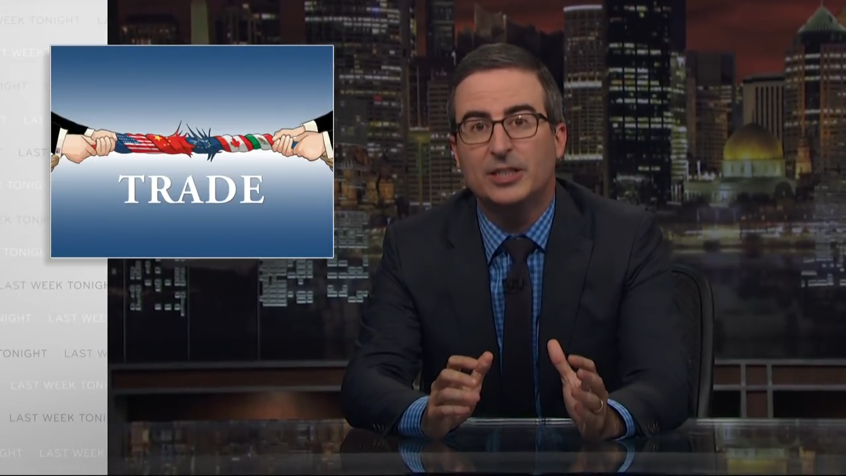
John Oliver: “Trade” 8/19/18 Manufacturing
Notes:
https://www.hbo.com/content/dam/hbodata/series/last-week-tonight-with-john-oliver/promo/s5/180820-ep140-trade-1920.jpg/_jcr_content/renditions/cq5dam.web.1200.675.jpeg

Slide 87

John Oliver: “Trade” 8/19/18 Steel
Notes:
https://www.hbo.com/content/dam/hbodata/series/last-week-tonight-with-john-oliver/promo/s5/180820-ep140-trade-1920.jpg/_jcr_content/renditions/cq5dam.web.1200.675.jpeg

Slide 88
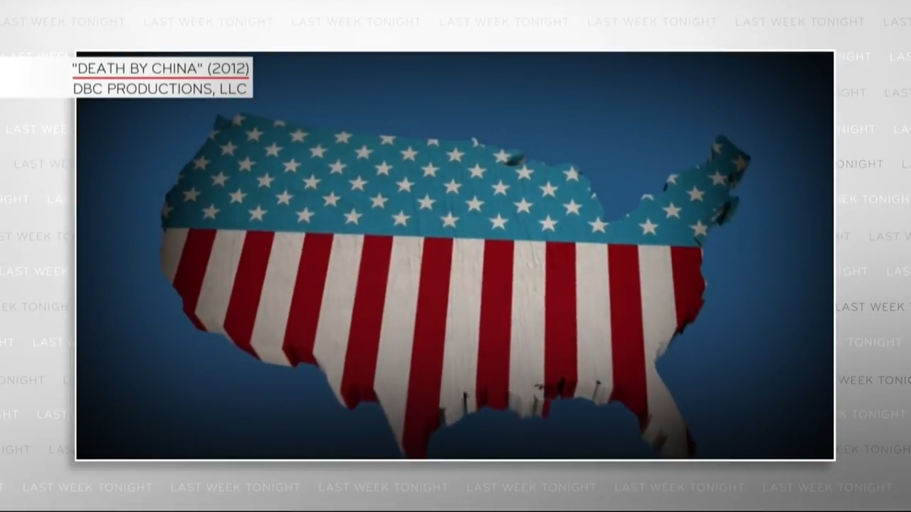
John Oliver: Death by China
Notes:
https://www.hbo.com/content/dam/hbodata/series/last-week-tonight-with-john-oliver/promo/s5/180820-ep140-trade-1920.jpg/_jcr_content/renditions/cq5dam.web.1200.675.jpeg

Slide 89
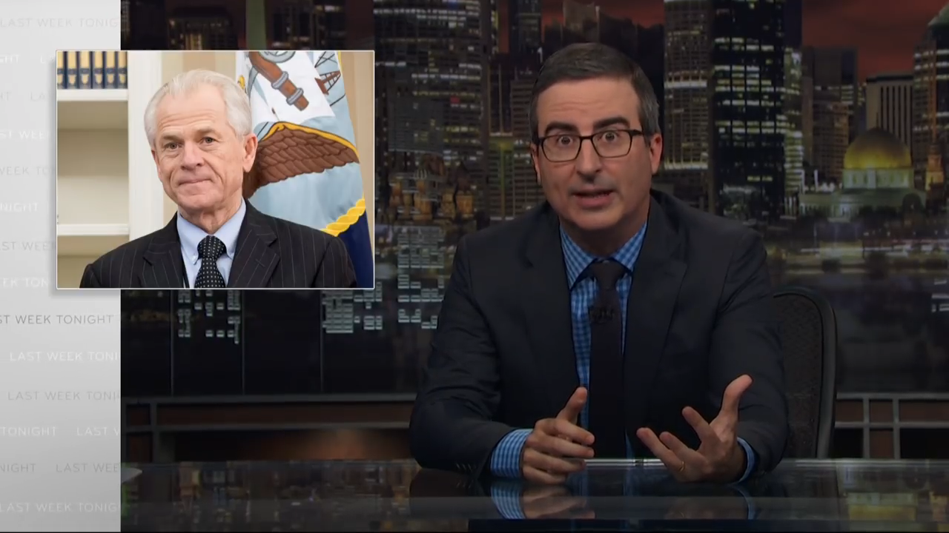
John Oliver: Death by Stupidity
Notes:
https://www.hbo.com/content/dam/hbodata/series/last-week-tonight-with-john-oliver/promo/s5/180820-ep140-trade-1920.jpg/_jcr_content/renditions/cq5dam.web.1200.675.jpeg

